Slide 1
Course Overview
Introduction to Algorithms
Sorting Algorithms P2
Module 1
Module 4
Graph Algorithms P2
Searching Algorithms P1
Module 8
Basic Data Structures
Module 5
Module 2
String Processing
Searching Algorithms P2
Module 6
Module 9
Sorting Algorithms P1
Other Topics
Module 3
Module 7
Graph Algorithms P1
Module 10
Notes:
This week, we study Basic Data Structures, which are fundamental components of algorithms and problem-solving.

Slide 2
MODULE 2: BASIC DATA STRUCTURES
Note: Some of these slides have been adapted from
slides freely available on the Internet and also from the
slides accompanying the course textbook.
Notes:
This week, we study Basic Data Structures, which are fundamental components of algorithms and problem-solving.

Slide 3
Revise previous week
Algorithms are step-by-step procedures for solving problems efficiently.
Big-O Notation helps analyze algorithm efficiency in terms of time and space complexity.
Algorithm Analysis can be done experimentally (running tests) or theoretically (counting operations). We focus on worst-case, best-case, and average-case scenarios.
Choosing the right algorithm depends on problem constraints, required efficiency, and available resources.
Recursion involves a function calling itself, with different types like tail, head, tree, nested, and indirect recursion.
Notes:
In the previous week, we covered the key algorithm concepts, including:
What are Algorithms?
Step-by-step procedures for solving problems efficiently.
Efficiency Analysis using Big-O Notation
Measures time complexity and space complexity to evaluate algorithm performance.
Different Cases of Algorithm Complexity
Best-case: The most optimal performance scenario.
Worst-case: The least efficient scenario.
Average-case: Expected performance across different inputs.
Choosing the Right Algorithm
Depends on problem constraints, efficiency needs, and available resources.
Recursion
A function calling itself to solve a problem.
Types of recursion include:
Tail Recursion: Recursive call is the last operation.
Head Recursion: Recursive call happens before processing.
Tree Recursion: Multiple recursive calls within a function.
Nested Recursion: A recursive call inside another recursive call.
Indirect Recursion: Functions call each other in a circular manner.

Slide 4
Learning outcomes
By the end of this lecture, students will gain:
Fundamental Understanding of Basic Data Structures
Knowledge of Abstract Data Types (ADTs)
Ability to Implement Stack, Queue Structures
Comparison of Expansion Strategies
Notes:
By the end of this lecture, students will gain:
Fundamental Understanding of Basic Data Structures
Covers essential concepts like arrays, linked lists, stacks, and queues.
Knowledge of Abstract Data Types (ADTs)
Understanding how ADTs define data structure operations abstractly.
Ability to Implement Stack and Queue Structures
Learning how to create and use stacks (LIFO) and queues (FIFO) effectively.
Comparison of Expansion Strategies
Analyzing different methods for handling dynamic data growth in structures.

Slide 5
Topics
Basic Data Structures
Abstract Data Types
Notes:
In this week,
We focus on Basic Data Structures and Abstract Data Types (ADTs), which are fundamental concepts in computer science and algorithm design.

Slide 6
Basic data structures
list
array
linked list
string
stack
queue
priority queue
graph
tree
set and dictionary
Topic: Basic data structures
Notes:
This slide covers basic data structures, which are fundamental ways to store and manage data efficiently.
List-Based Structures
Array: Fixed-size, indexed collection of elements.
Linked List: Dynamic collection of nodes linked together.
String: Sequence of characters, often treated as a list of characters.
Stack and Queue
Stack: Follows LIFO (Last In, First Out) order.
Queue: Follows FIFO (First In, First Out) order.
Priority Queue: Elements are dequeued based on priority rather than order of insertion.
Advanced Structures
Graph: Represents relationships between elements using nodes and edges.
Tree: A hierarchical structure with a root node and child nodes.
Set and Dictionary:
Set: Unordered collection of unique elements.
Dictionary (Map): Stores key-value pairs for fast lookup.

Slide 7
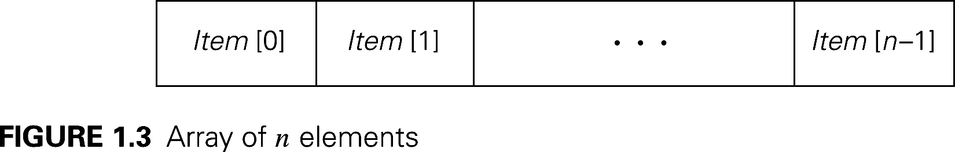
Basic data structures
Topic: Basic data structures
Notes:
What is an Array?
Array is a fixed-size, sequential collection of items of the same variable type that are stored at contiguous memory locations. It is one of the most popular and simple data structures used in programming.
Basic terminologies of Array:
Array Index: In an array, elements are identified by their indexes. Array index starts from 0.
Array element: Elements are items stored in an array and can be accessed by their index.
Array Length: The length of an array is determined by the number of elements it can contain.

Slide 8
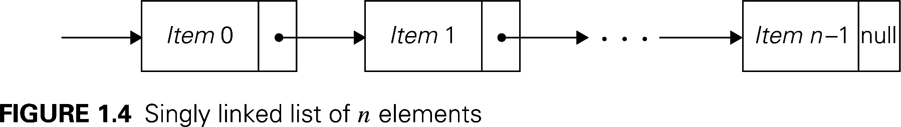
Basic data structures
Topic: Basic data structures
Notes:
Singly Linked List: Each node points to the next node only.
What is a Singly Linked List?
A singly linked list is a linear data structure where elements (nodes) are connected sequentially, with each node pointing to the next node in the sequence. Unlike arrays, linked lists do not use contiguous memory.
Structure of a Node in a Singly Linked List: 2 parts
Data – Stores the value.
Pointer (next) – Points to the next node in the list.

Slide 9
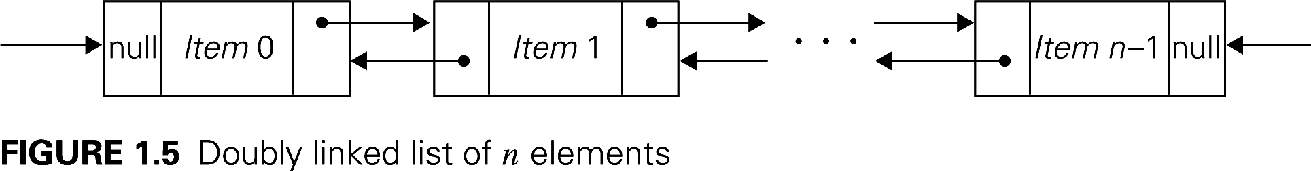
Basic data structures
Topic: Basic data structures
Notes:
Doubly Linked List: Each node has pointers to both next and previous nodes.
What is a Doubly Linked List?
A doubly linked list (DLL) is a linear data structure where each node has two pointers:
Prev – Points to the previous node.
Next – Points to the next node.
Unlike a singly linked list, a doubly linked list allows traversal in both directions.
Structure of a Node in a Doubly Linked List: 3 parts
Data – Stores the value.
Prev Pointer – Points to the previous node.
Next Pointer – Points to the next node.

Slide 10
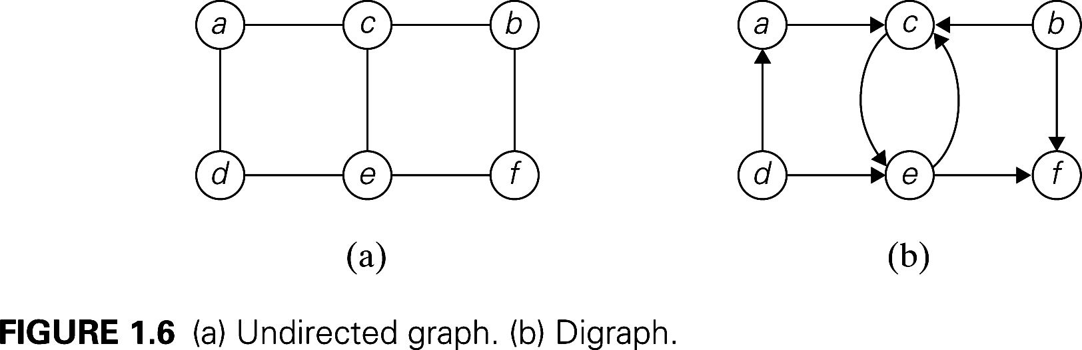
Basic data structures
Topic: Basic data structures
Notes:
This slide presents two types of graphs used in data structures:
Undirected Graph (a)
The edges do not have a direction.
Connections between nodes (vertices) are bidirectional.
Example: a — c, meaning c — a is also valid.
Directed Graph (Digraph) (b)
The edges have a specific direction indicated by arrows.
Example: a → c means c is reachable from a, but not necessarily vice versa.
Contains a self-loop at node e (i.e., e → e).
Key Takeaways
Undirected graphs model symmetric relationships (e.g., social networks).
Directed graphs model asymmetric relationships (e.g., web links, dependency graphs).

Slide 11
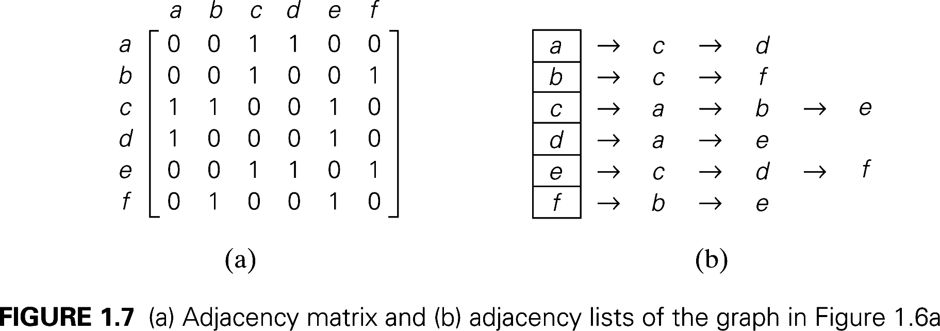
Basic data structures
Topic: Basic data structures
Notes:
This slide presents two common representations of graphs:
Adjacency Matrix (a)
A 2D matrix where rows and columns represent vertices.
A value of 1 at (i, j) means an edge exists between vertex i and j, while 0 means no edge.
Example: In the matrix, a → c (row a, column c) has a 1, meaning a and c are connected.
Adjacency List (b)
A more space-efficient representation.
Each vertex stores a list of its neighbors.
Example: a → c → d means a is connected to c and d.
Adjacency Matrix is faster for edge lookups O(1) but takes O(V²) space. Adjacency List is more memory-efficient for sparse graphs, taking O(V + E) space.

Slide 12
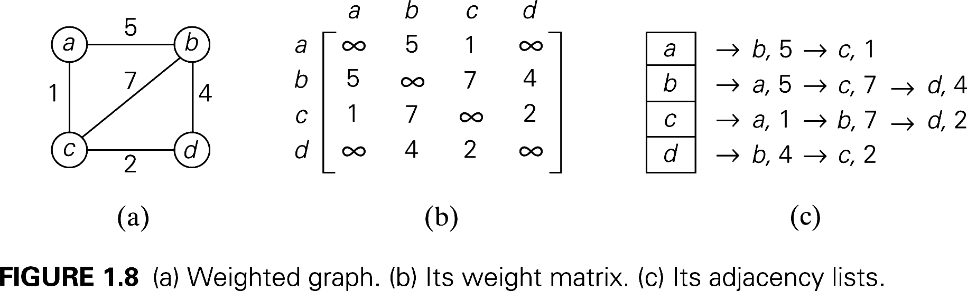
Basic data structures
Topic: Basic data structures
Notes:
Graph Representations
There are three primary ways to represent graphs in data structures:
1. Weighted Graph Representation (Figure 1.8a)
The given graph is undirected and weighted.
The edges have associated weights, indicating the cost, distance, or relationship strength between nodes.
Example: The edge between a and b has a weight of 5, while the edge between c and d has a weight of 2.
2. Weight Matrix Representation (Figure 1.8b)
A weight matrix (adjacency matrix) is a 2D array where:
Rows and columns represent nodes.
Matrix[i][j] stores the weight of the edge between nodes i and j.
If there is no edge between two nodes, the matrix stores ∞ (infinity) or a large value.
Properties:
Space Complexity: O(V2)O(V2), where VV is the number of vertices.
Best Use Case: Suitable for dense graphs where most nodes are connected.
Example:
[∞51∞5∞7417∞2∞42∞]​∞51∞​5∞74​17∞2​∞42∞​​The value at (a, b) and (b, a) is 5, indicating an undirected edge with weight 5.
3. Adjacency List Representation (Figure 1.8c)
Adjacency lists store a list of connected nodes for each vertex.
Each entry contains a vertex and the weight of the edge connecting it.
Space Complexity: O(V+E)O(V+E), where EE is the number of edges.
Best Use Case: Suitable for sparse graphs where most nodes are not fully connected.
Example:
a → (b, 5) → (c, 1)
b → (a, 5) → (c, 7) → (d, 4)
c → (a, 1) → (b, 7) → (d, 2)
d → (b, 4) → (c, 2)
Comparing Graph Representations
RepresentationSpace ComplexityLookup Time (Edge Exists)Best ForAdjacency MatrixO(V2)O(V2)O(1)O(1)Dense graphsAdjacency ListO(V+E)O(V+E)O(d)O(d) (where dd is degree of node)Sparse graphsApplications of Graphs
Social Networks: Users (nodes) connected by friendships (edges).
Maps and Navigation: Locations (nodes) connected by roads (edges) with distances (weights).
Computer Networks: Routers (nodes) connected by network links (edges).
Summary
Graphs model relationships between objects.
Weight matrices provide quick lookups but use more space.
Adjacency lists are more space-efficient and useful for sparse graphs.
Choosing the right graph representation depends on the problem requirements.

Slide 13
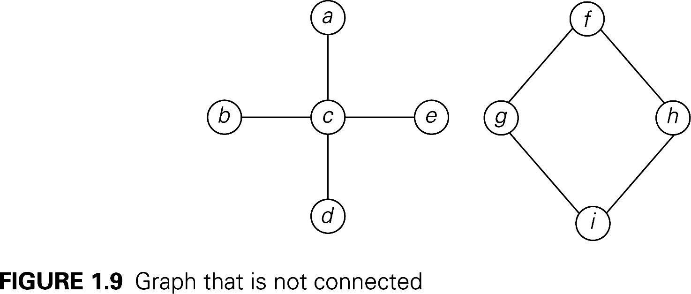
Basic data structures
Topic: Basic data structures
Notes:
What Is a Disconnected Graph?
A disconnected graph is a graph in which not all vertices (nodes) are connected through a sequence of edges. This means there exist two or more groups of nodes that have no path between them.
Example of this Image:
Component 1: {a, b, c, d, e} – Nodes are connected in a star-like structure with c as the central node.
Component 2: {f, g, h, i} – Forms a diamond-like structure where each node connects to at least two others.
No edge exists between Component 1 and Component 2, making the graph disconnected.

Slide 14
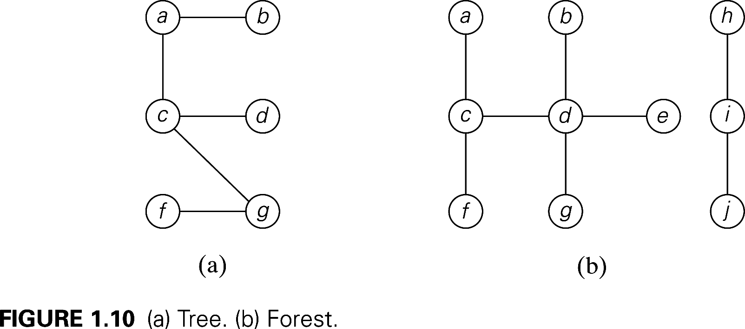
Basic data structures
Topic: Basic data structures
Notes:
This slide illustrates weighted graph representations.
Weighted Graph (a)
A graph where edges have weights (costs).
Example: a → b has a weight of 5, meaning the cost to travel from a to b is 5.
Weight Matrix (b)
Similar to an adjacency matrix, but instead of 1 for edges, it stores weights.
∞ (infinity) represents no direct connection between nodes.
Example: a → c has weight 1, so position (a, c) is 1.
Adjacency List (c)
Each node maintains a list of neighbors and corresponding edge weights.
More efficient in space for sparse graphs.
Example: a → b, 5 → c, 1 means a is connected to b with weight 5 and c with weight 1.

Slide 15
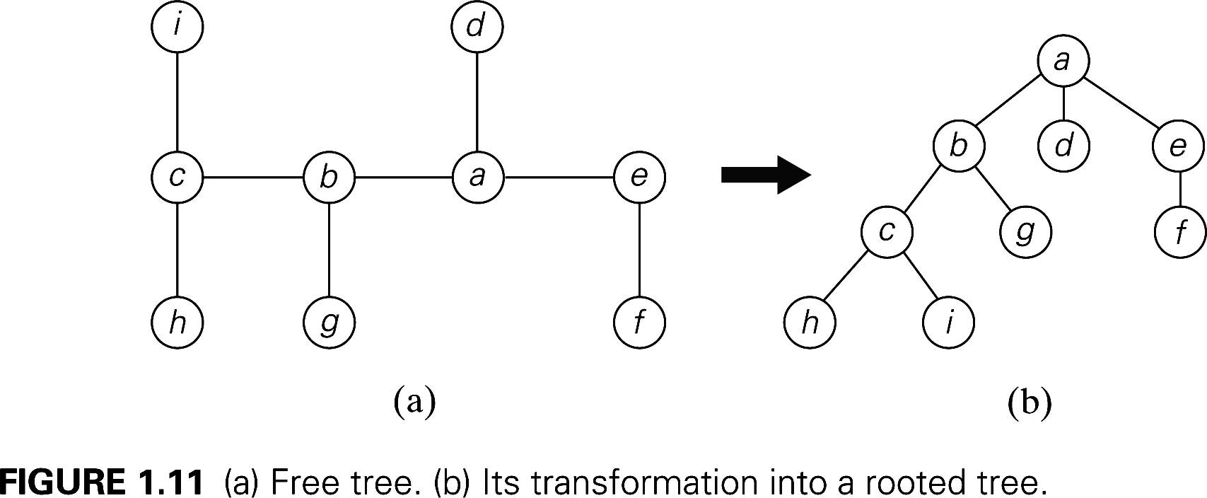
Basic data structures
Topic: Basic data structures
Notes:
Free Tree
A free tree is an undirected, connected, acyclic graph with no designated root.
It consists of nodes (vertices) and edges but has no hierarchical structure.
Any node can be considered the "top," as there is no parent-child relationship.
Nodes are symmetrically connected, meaning any node could potentially serve as the root.
Free Tree in Figure 1.11a:
The tree is unordered and does not have a fixed hierarchy.
Nodes {c, b, e, a, d, f, g, h, i} are connected without a specific direction.
There is no defined root node, and relationships between nodes are flexible.
Rooted Tree
A rooted tree is a tree where one node is designated as the root, creating a hierarchical structure.
One node becomes the root (in this case, a).
Every other node is organized as a descendant of the root.
Edges now have a direction, defining parent-child relationships.
Rooted Tree in Figure 1.11b:
Node a is now the root of the tree.
Nodes {b, c, d, e, f, g, h, i} are arranged hierarchically under a.
Parent-child relationships are now established:
a → {b, d, e}
b → {c, g}
c → {h, i}

Slide 16
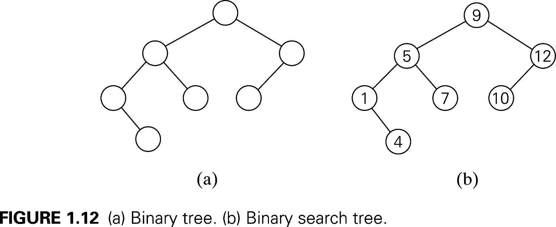
Basic data structures
Topic: Basic data structures
Notes:
Binary Tree
A Binary Tree is a tree data structure where:
Each node has at most two children: a left child and a right child.
It does not enforce any ordering rule among the elements.
Binary Tree in Figure 1.12a:
The structure follows a hierarchy with a root node.
Each node can have zero, one, or two child nodes.
No specific ordering is applied between parent and child nodes.
Binary Search Tree
A Binary Search Tree (BST) is a binary tree that follows a specific ordering rule:
Left child contains values smaller than the parent.
Right child contains values greater than the parent.
Binary Search Tree in Figure 1.12b:
The root node is 9, and it follows the BST rule:
Left subtree of 9: {5, 1, 4, 7} (all values less than 9).
Right subtree of 9: {12, 10} (all values greater than 9).
Every subtree also follows the BST rule, making searching efficient.

Slide 17
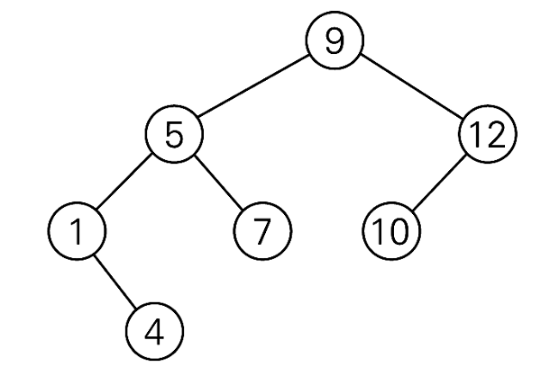
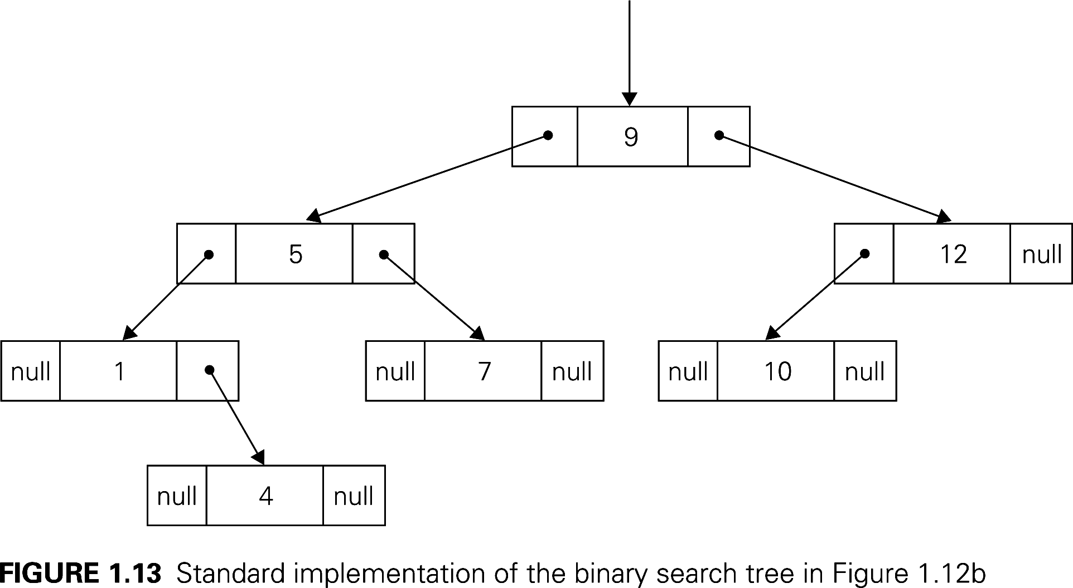
Basic data structures
Topic: Basic data structures
Notes:
Standard implementation of the BST in Figure 1.12b
The root node is 9.
The left subtree contains {5, 1, 4, 7} (all values less than 9).
The right subtree contains {12, 10} (all values greater than 9).
Each node is represented as a block containing:
A value in the center.
Left and right pointers directing to child nodes or null (if no child exists).
Step-by-Step Breakdown of the BST Implementation
Root Node (9)
Left child → 5
Right child → 12
Node 5 (Left Subtree of 9)
Left child → 1
Right child → 7
Node 1 (Left Subtree of 5)
Left child → null
Right child → 4
Node 4 (Right Subtree of 1)
Left child → null
Right child → null
Node 7 (Right Subtree of 5)
Left child → null
Right child → null
Node 12 (Right Subtree of 9)
Left child → 10
Right child → null
Node 10 (Left Subtree of 12)
Left child → null
Right child → null

Slide 18
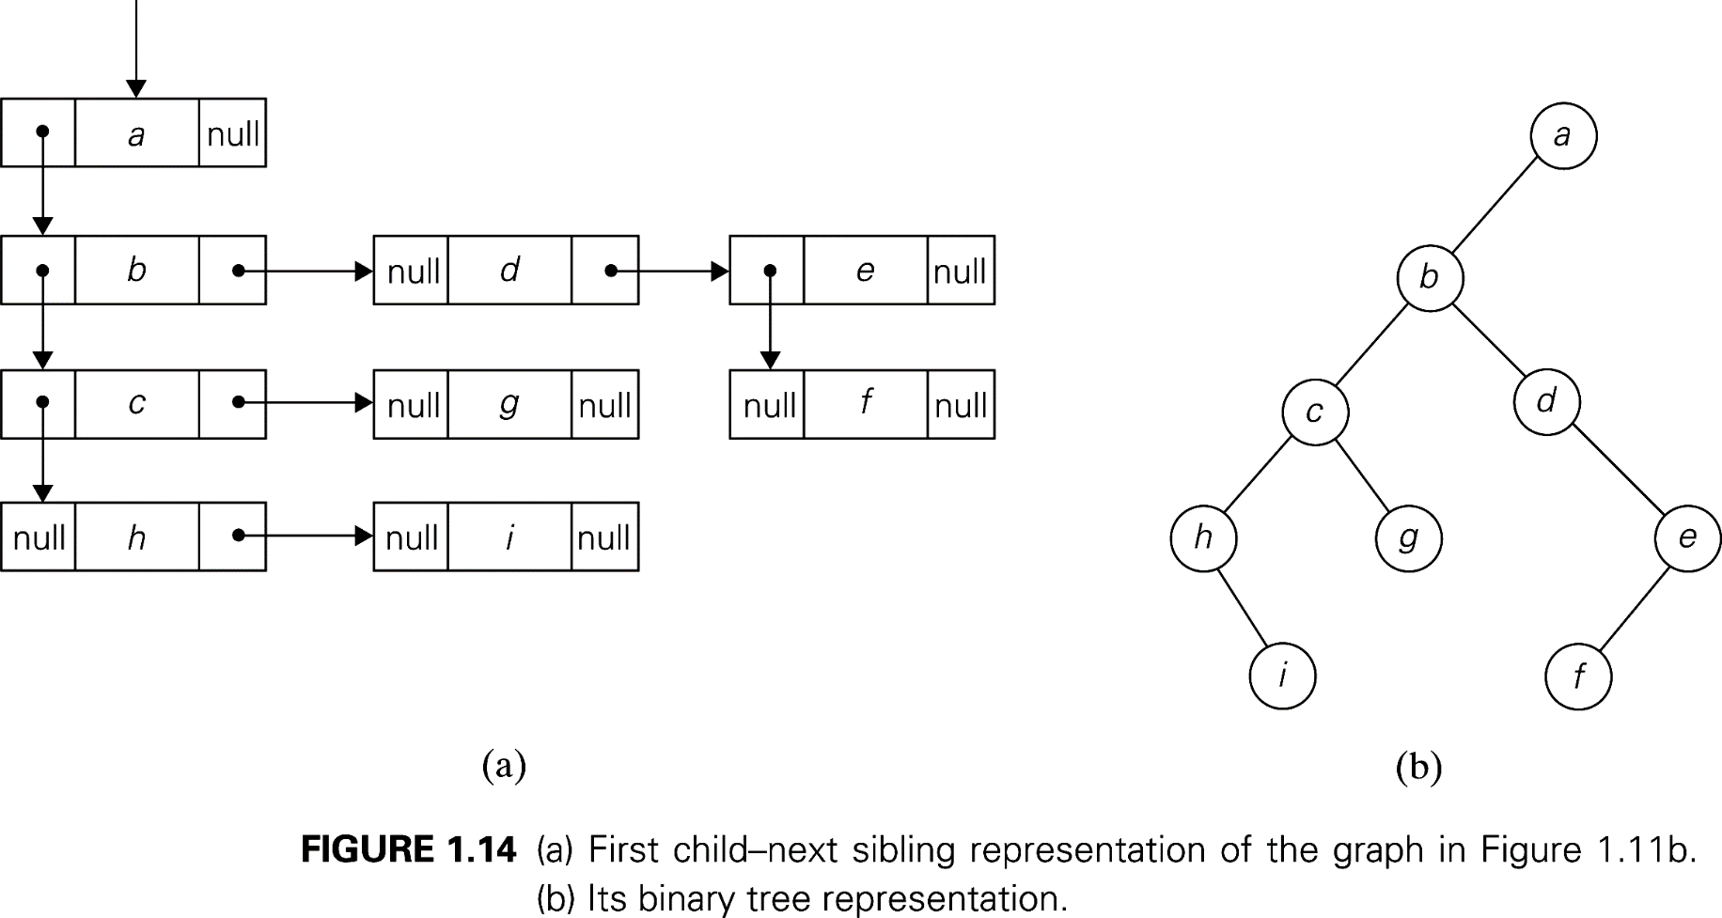
Basic data structures
Topic: Basic data structures
Notes:
First Child–Next Sibling Representation (Figure 1.14a)
This is a tree representation technique that efficiently stores multi-way trees (trees where nodes can have more than two children) using only two pointers per node:
First Child Pointer → Points to the first child of a node.
Next Sibling Pointer → Points to the next sibling of the node (same level with the First Child).
Explain the case in Figure 1.14a:
Each node stores two references:
First child (left pointer).
Next sibling (right pointer).
Example:
Node a has children {b, d, e}.
b is the first child of a, so a → b.
d is the next sibling of b, so b → d.
e is the next sibling of d, so d → e.
Binary Tree Representation (Figure 1.14b)
This representation converts the first child–next sibling tree into a standard binary tree, where:
Left child → Represents the first child.
Right child → Represents the next sibling.
Explain the case in Figure 1.14b:
Node a remains the root.
b is the first child of a, so b becomes a's left child.
d is the next sibling of b, so d becomes b's right child.
The tree structure maintains hierarchical relationships using only two pointers per node.

Slide 19
Abstract Data Types
An abstract data type (ADT) is an abstraction of a data structure
An ADT specifies the type of data stored and the different operations you can perform on it
Think of an ADT like a Java interface
It specifies the name and purpose of the methods, but not their implementations
Topic: Abstract Data Types
Notes:
An ADT is an abstraction of a data structure, focusing on what operations can be performed rather than how they are implemented.
It defines the type of data stored and the operations available, such as insertion, deletion, and access.
Example Analogy:
Think of an ADT like a Java interface. It defines method names and their purposes, but not the actual implementation.
Why Use ADTs?
Promotes modularity by separating implementation details.
Allows flexibility in changing implementations without affecting how the ADT is used.
Forms the foundation for various data structures like Lists, Stacks, and Queues.

Slide 20
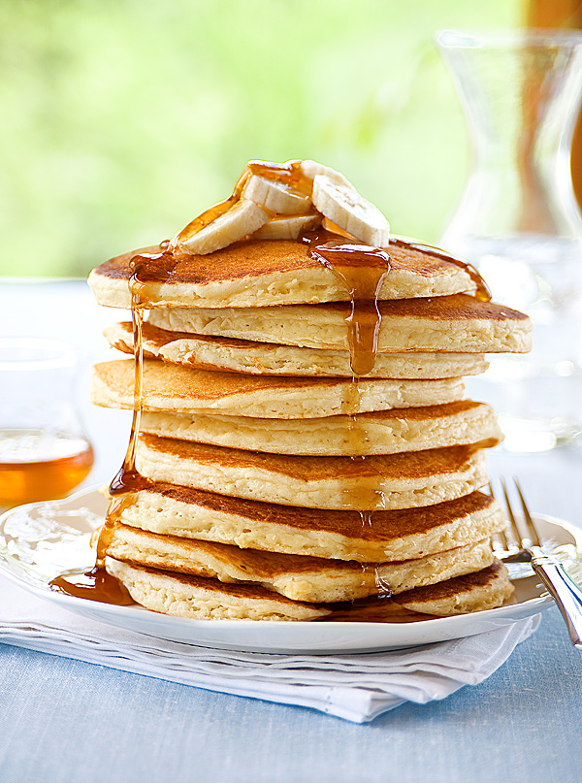
The Stack ADT
The stack ADT stores arbitrary objects
Insertions and deletions follow a LIFO (last-in, first-out) scheme
There are many ways you could implement the stack ADT
Topic: Abstract Data Types
Notes:
This slide introduces the Stack Abstract Data Type (ADT):
Definition:
A stack is a data structure that stores arbitrary objects.
Operations are restricted to the top of the stack.
LIFO Principle:
Last-In, First-Out (LIFO): The last item added is the first one removed.
Example: Similar to a stack of pancakes—you always take from the top first.
Implementation Focus:
There are many ways to implement the Stack ADT, but today we will focus on using an array-based implementation.

Slide 21
Stack ADT specifications
push(object): inserts an element
object pop(): removes and returns the last inserted element
int size(): returns the number of elements stored in the stack
boolean isEmpty(): indicates whether the stack has no elements
Topic: Abstract Data Types
Notes:
Now that we've introduced the concept of the Stack ADT, let's go over its fundamental operations. A stack follows the Last-In, First-Out (LIFO) principle, meaning that the last element added is the first one to be removed. To work with a stack, we typically use four key operations:"
push(object) – This method inserts an element onto the stack. Every time you push an object, it is placed on top of the stack.
pop() – This removes and returns the last inserted element. Since the stack follows LIFO, the most recently added element will be the first one to be removed.
size() – This function simply returns the number of elements currently stored in the stack. It helps us track how many elements are in the stack at any given time.
isEmpty() – This method checks if the stack is empty. If there are no elements in the stack, it returns true; otherwise, it returns false.

Slide 22
Capped-capacity Stack
One implementation of a stack uses an array as the underlying data structure
However, with an array you can only have as many objects in the stack as the capacity of the array
Topic: Abstract Data Types
Notes:
A stack can be implemented using an array as the underlying data structure. This is called a capped-capacity stack because its size is limited by the array's fixed capacity.
Elements are stored in an array, with an index tracking the top of the stack.
Once the array is full, no more elements can be pushed unless the array is resized, which can be inefficient.
This method is simple and efficient for fixed-size problems but may not be ideal for dynamic applications.

Slide 23
Capped-capacity Stack (2)
Stack():
data = array of size 20
count = 0
function push(obj):
if count < 20:
data[count] = obj
count += 1
else:
error(“Overfull stack”)
function size():
return count
function isEmpty():
return count == 0
function pop():
if count == 0:
error(“Can’t pop from empty stack”)
else:
count -= 1
return data[count]
What are the runtimes of these operations?
Topic: Abstract Data Types
Notes:
All of the operations are O(1)
size() → O(1)
Simply returns count, which is a constant-time lookup.
isEmpty() → O(1)
Checks if count == 0, which is a constant-time operation.
push(obj) → O(1)
Assigning obj to data[count] and incrementing count are constant-time operations.
pop() → O(1)
Decrements count and returns data[count], both of which take constant time.

Slide 24
Expandable Stack
The capped-capacity stack is fast but not very useful
How can we make an array-based stack that has unlimited capacity?
Incremental strategy: increase the size of the array by a constant c when capacity is reached
Doubling strategy: double the size of the array when capacity is reached
Problem: arrays cannot be resized. You can only copy over elements to a new array
Topic: Abstract Data Types
Notes:
A capped-capacity stack (fixed-size array stack) is fast but limited because it cannot grow dynamically.
Two common strategies allow an array-based stack to grow when it reaches capacity:
Incremental Strategy → Increase the array size by a constant c when full.
Doubling Strategy → Double the size of the array when full.
Challenges of Expanding Stacks
Arrays cannot be resized dynamically, so a new larger array must be created.
All elements must be copied over to the new array, which takes time.

Slide 25
Expandable Stack (2)
Stack():
data = array size 20
count = 0
capacity = 20
function push(obj):
// Input: obj to insert into stack
// Output: none
data[count] = obj
count += 1 if count == capacity: // Resize if now full new_capacity = capacity+c for incremental
capacity*2 for doubling
new_data = array of size new_capacity
for i = 0 to capacity-1:
new_data[i] = data[i]
capacity = new_capacity
data = new_data
What’s the runtime of push when the stack doesn’t expand? O(1)
When it does expand?
Incremental: O(n)
Doubling: O(n)
Topic: Abstract Data Types
Notes:
Stack Initialization:
The stack starts with a fixed capacity (e.g., 20 elements).
It tracks the number of elements (count) and total capacity.
Push Operation and Expansion:
If the stack is not full, inserting an element (push()) is O(1).
If the stack is full, it must expand:
Incremental Strategy: capacity + c (adds a fixed amount).
Doubling Strategy: capacity * 2 (doubles the size).
A new array is created, and all elements are copied over.
Key Takeaways:
Incremental growth is inefficient for large stacks (O(n²) over time).
Doubling growth is more efficient (O(n), but amortized O(1) for each push).
Choosing the right strategy depends on memory availability and performance needs.

Slide 26
Comparison of the Strategies
Which is better?
Compare the incremental strategy and the doubling strategy by analyzing the total time T(n) needed to perform a series of n push operations
Amortized (average) analysis: time required to perform a sequence of operations averaged over all the operations performed
amortized time of a push operation: T(n)/n
Topic: Abstract Data Types
Notes:
Let's compare incremental strategy and doubling strategy.
How do we analyze the efficiency of push operations?
We analyze this by looking at the total time T(n) needed for n push operations.
Amortized (average) analysis
Instead of analyzing each individual push, we calculate the total time and distribute it evenly over all operations.
The formula for amortized time of a push:
T(n)/n
This helps us understand the true cost per operation over the long run.

Slide 27
Analysis of Incremental Strategy
Consider a stack that expands by c = 5 whenever it reaches capacity (capacity will begin at c as well to simplify analysis)
The 5th push brings the stack to capacity, requiring all 5 elements to be copied to an array of size 5 + c = 10
We can calculate the average cost per push:
operations per push
Is each push operation O(1)?
constant pushes
1st expansion
The capacity only doubles in this first example since the initial capacity is also c
Topic: Abstract Data Types
Notes:
The stack starts with a fixed capacity (c = 5) and expands by adding c elements each time it reaches capacity.
Example: When the 5th push occurs, the stack reaches full capacity, requiring all 5 elements to be copied into a new array of size 10 (original size + c).
This copying process repeats every time the stack is full, leading to frequent memory reallocations and data transfers.
The average cost per push can be calculated as (5 + 5) / 5 ≈ 2 operations per push.
Key Question: Does each push still run in O(1) time complexity, or does expansion make it worse?

Slide 28
Analysis of Incremental Strategy
What if we push five more elements?
Constant until the 10th push brings the stack to capacity, requiring all 10 elements to be copied to an array of size 10 + c = 15
The average cost per push, again:
n/c = 10/5 = 2 expansions
And so forth…
15 pushes:
n/c = 3 expansions
20 pushes:
n/c = 4 expansions
constant pushes
1st
2nd expansion
Looks linear…
Topic: Abstract Data Types
Notes:
If 5 more elements are added, the 10th push triggers another expansion, copying all 10 elements to a new array of size 15 (10 + 5).
The cost per push continues increasing as the stack grows:
At n = 10, the average cost per push is (10 + 15) / 10 ≈ 2.5.
At n = 15, there have been 3 expansions, leading to an average cost of 3 per push.
At n = 20, there have been 4 expansions, the cost per push increases further to 3.5.
Conclusion
The trend suggests that the cost of pushing grows linearly with the number of elements rather than constant-time O(1).
Each expansion increases cost, making incremental resizing inefficient.
More elements → More frequent copying → Higher cost per operation.

Slide 29
Analysis of Incremental Strategy
n push operations without expansion
about n/c expansions, each copies c more
factoring out c
rewriting 1+2+…+k as
distributing and simplifying
Topic: Abstract Data Types
Notes:
To compute the total cost T(n) of performing n push operations, we analyze:
Each push operation incurs an O(1) time cost, except when expansion occurs.
The stack expands every n/c times, and each expansion requires copying all elements from the old array to the new one.
The total work done follows a summation pattern: c + 2c + 3c + ... + (n/c)c.
The sum 1 + 2 + 3 + ... + k simplifies to (k(k+1))/2, leading to a total cost of O(n²).
Conclusion
Incremental expansion leads to O(n²) total time.
This is inefficient compared to other strategies like doubling expansion.

Slide 30
Analysis of Incremental Strategy
Total time T(n) of a series of n push operations is O(n²) for incremental
Amortized time of a single push operation is therefore T(n)/n = O(n) using the incremental strategy for an expanding stack
Topic: Abstract Data Types
Notes:
Total time for n push operations: O(n²).
To get the amortized cost per push, divide total time T(n) by n:
T(n) / n = O(n) per push.
This means each push operation is not truly O(1) but O(n) amortized when using incremental expansion.
Key issue: As the stack grows, each push becomes increasingly expensive.
Why is this bad?
Each push becomes progressively more expensive due to frequent copying.
Not ideal for large dynamic stacks

Slide 31
Analysis of Doubling Strategy
What about for a doubling stack with initial capacity of 20 (chosen arbitrarily)?
Pushes are constant until double at the 20th push
The average cost per push, again:
And so forth…
40 pushes:
80 pushes:
constant pushes
1st expansion
constant pushes
2nd
1st expansion
Looks like it converges…
Topic: Abstract Data Types
Notes:
A stack with an initial capacity of 20 follows the doubling strategy.
Elements are pushed into the stack without expansion until the 20th push.
When full, the capacity is doubled, and all elements are copied to the new array.
The cost per push is calculated:
First 20 pushes: Cost = (20 + 20) / 20 ≈ 2
After 40 pushes: Cost = (40 + 40 + 20) / 40 ≈ 2.5
After 80 pushes: Cost = (80 + 80 + 40 + 20) / 80 ≈ 2.75
Observation
The cost converges to a small constant value, indicating efficient performance.
Doubling strategy is significantly more efficient than incremental growth.

Slide 32
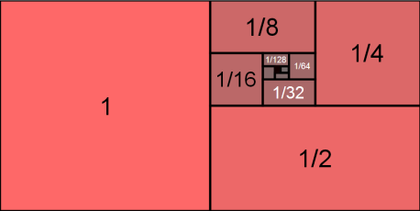
Analysis of Doubling Strategy
For a stack with n elements, the total work done to push all the elements (constant pushes and k expansions) is:
Amortized time of a single push operation is therefore T(n)/n = O(1) using the doubling strategy
n push operations without expansion
k expansions
geometric series:
Topic: Abstract Data Types
Notes:
The total work done to push all n elements includes:
n direct pushes.
k expansions, each involving copying elements.
The summation follows a geometric series:
Total work: T(n) = n+n(1+1/2+1/4+...+1/2^(k−1))
The geometric series converges to 2, leading to T(n)<3n
The amortized cost of each push operation:
T(n)/n=O(1), meaning each push operation is effectively constant time on average.

Slide 33
Amortized Thinking
“Amortized” analysis:
For each fast operation, place an extra unit of time “in the bank”
By the time an expensive operation arrives, use your savings to pay for it!
Alternative view:
When you do an expensive operation
Pay one unit now
Pay an extra unit for each of the next n operations
Topic: Abstract Data Types
Notes:
Amortized Analysis is a method to analyze the average time complexity of an operation over a sequence of operations, rather than a single operation.
Concept of “Banking Time”:
For each fast operation, save an extra unit of time, like putting money in the bank.
When an expensive operation occurs, use the accumulated savings to pay for it.
Alternative Explanation:
When performing an expensive operation, instead of taking the full cost at once:
Pay one unit now.
Pay an extra unit over the next n operations.
This method helps in analyzing operations like resizing arrays or self-balancing trees, where occasional expensive operations are offset by many cheap ones, leading to O(1) amortized time complexity in certain cases.

Slide 34

The Queue ADT
First-in, first-out (FIFO)
enqueue(obj): inserts an element at the end of the queue
object dequeue(): removes and returns the element at the front of the queue
int size(): returns the number of elements stored in the queue
boolean isEmpty(): indicates if the queue has no elements
Topic: Abstract Data Types
Notes:
A Queue is a linear data structure that follows the FIFO (First-In, First-Out) principle.
The first element added is the first element removed (similar to a line of people waiting).
Applications:
Job scheduling (e.g., CPU scheduling).
Data buffering in networks.
Breadth-First Search (BFS) in graph traversal.

Slide 35
Expandable Queue
We can also implement a queue using an expanding array, but with a slight complication
Unlike a stack, we need to keep track of the head and the tail of the queue
What happens if the tail reaches the end of the array, but there’s still room at the front? Is the queue full?
0
1
2
head
tail
Topic: Abstract Data Types
Notes:
What happens if the tail reaches the end of the array, but there’s still room at the front?
In a simple array-based queue, the queue would be considered full, even if there is space at the front.
The issue arises because enqueue always happens at the tail and dequeue happens at the head, leading to unused space at the front after multiple dequeues.
Solution: Circular Queue → Instead of shifting elements, the tail wraps around to the beginning when it reaches the end.
This ensures continuous memory usage and avoids unnecessary copying.
Is the queue full in this situation?
In a simple queue, yes—it appears full because the tail is at the last index.
In a circular queue, no, because we can insert at the empty front slots.
The queue is only truly full when (tail + 1) % capacity == head, meaning no free space exists.

Slide 36
Expandable Queue (2)
Wrap the queue!
Expand the array when queue is completely full
When copying, “unwind” the queue so the head starts back at 0
0
1
2
tail
head
function enqueue(obj):
if size == capacity:
double array and copy contents
reset head and tail pointers
data[tail] = obj
tail = (tail + 1) % capacity size++
function dequeue():
if size == 0:
error(“queue empty”)
element = data[head]
head = (head + 1) % capacity
size -= 1
return element
head
tail
Topic: Abstract Data Types
Notes:
Amortized runtime of enqueue is also O(1)
Circular Queue Behavior
Wrap around the queue when it reaches the end, reusing available space.
Expand the array only when it is completely full.
Advantages of Circular Queues
Efficiently utilizes memory without shifting elements.
O(1) time complexity for enqueue and dequeue operations.

Slide 37
Summary
List: Includes arrays (fast access) and linked lists (dynamic allocation).
Graph: Represented using adjacency lists or matrices; can be directed or undirected.
Tree: Hierarchical structure, includes binary trees and binary search trees (BST).
Stack: Follows LIFO (Last-In, First-Out), supports push(), pop(), and resizing strategies (incremental vs. doubling).
Queue: Follows FIFO (First-In, First-Out), supports enqueue(), dequeue(), and can be expanded using circular queues.
Amortized Analysis: Helps evaluate average time complexity, proving doubling strategy is more efficient (O(1) amortized time).
Notes:
This summarizes key data structures and concepts:
List: Arrays (fast access) and linked lists (dynamic allocation).
Graph: Uses adjacency lists or matrices, can be directed or undirected.
Tree: Hierarchical structure, includes binary trees and BSTs.
Stack: Follows LIFO, supports push(), pop(), and resizing strategies.
Queue: Follows FIFO, supports enqueue(), dequeue(), and circular queues.
Amortized Analysis: Helps analyze average time complexity. Doubling strategy achieves O(1) amortized time.

